Slide 1
Software Engineering BCA IV SEM
Chapter VII
Software Maintenance
Bijay Babu Regmi
bijay.regmi@deerwalk.edu.np

Slide 2
Changing nature of Software
System Software
a collection of programs which are written to service other programs
the system software area is characterized by the heavy interaction with computer hardware that requires scheduling, resource sharing, and sophisticated process management
Application Software
defined as programs that solve a specific business need
is also used to control business function in real time
application in this area process business or technical data in a way that facilitates business operation or management technical decision making

Slide 3
Continued….
Engineering and Scientific Software
is used to facilitate the engineering function and task
computer-aided design, system simulation, and other interactive applications have begun to take a real-time and even system software characteristic
Embedded Software
resides within the system or product and is used to implement and control feature and function for the end-user and for the system itself
Embedded software can perform the limited and esoteric function or provided significant function and control capability

Slide 4
Continued….
Product Line Software
designed to provide a specific capability for use by many different customers, product line software can focus on the limited and esoteric marketplace or address the mass consumer market
Web Application
is a client-server computer program which the client runs on the web browser
as e-commerce and B2B application grow in importance, Web apps are evolving into a sophisticate computing environment that not only provides a standalone feature, computing function, and content to the end user
Artificial Intelligence Software
makes use of a non numerical algorithm to solve a complex problem that is not amenable to computation or straightforward analysis
Application within this area includes robotics, expert system, pattern recognition, artificial neural network, theorem proving and game playing

Slide 5
Software Maintenance
Software maintenance is the general process of changing a system after it has been delivered. The term is usually applied to custom software in which separate development groups are involved before and after delivery. The changes made to the software may be simple changes to correct coding errors, more extensive changes to correct design errors, or significant enhancements to correct specification errors or accommodate new requirements. Changes are implemented by modifying existing system components and, where necessary, by adding new components to the system.
There are different types of software maintenance:
Fault repairs: Coding errors are usually relatively cheap to correct; design errors are more expensive as they may involve rewriting several program components. Requirements errors are the most expensive to repair because of the extensive system redesign which may be necessary.
Environmental adaptation: This type of maintenance is required when some aspect of the system’s environment such as the hardware, the platform operating system, or other support software changes. The application system must be modified to adapt it to cope with these environmental changes.
Functionality addition: This type of maintenance is necessary when the system requirements change in response to organizational or business change. The scale of the changes required to the software is often much greater than for the other types of maintenance.

Slide 6
Continued….
Corrective maintenance: Corrective maintenance of a software product may be essential either to rectify some bugs observed while the system is in use, or to enhance the performance of the system.
Adaptive maintenance: This includes modifications and updations when the customers need the product to run on new platforms, on new operating systems, or when they need the product to interface with new hardware and software.
Perfective maintenance: A software product needs maintenance to support the new features that the users want or to change different types of functionalities of the system according to the customer demands.
Preventive maintenance: This type of maintenance includes modifications and updations to prevent future problems of the software. It goals to attend problems, which are not significant at this moment but may cause serious issues in future.

Slide 7
Software Maintenance Prediction
Since unexpected maintenance costs may lead to an unexpected increase in costs, it is important to predict the effect of modifications in the software system.
Software maintenance prediction refers to the study of software maintainability, the modifications in the software system, and the maintenance costs that are required to maintain the software system. Various maintenance predictions and the questions associated with them.
Various predictions are closely related and specify the following.
1. The decision to accept a system change depends on the maintainability of the system components affected by that change up to a certain extent.
2. Implementation of changes results in degradation of system structure as well as reduction in system maintainability.
3. Costs involved in implementing changes depend on the maintainability of the system components.
To predict the number of changes requested for a system, the relationship between the system and its external environment should be properly understood. To know the kind of relationship that exists, organizations should assess the following.

Slide 8
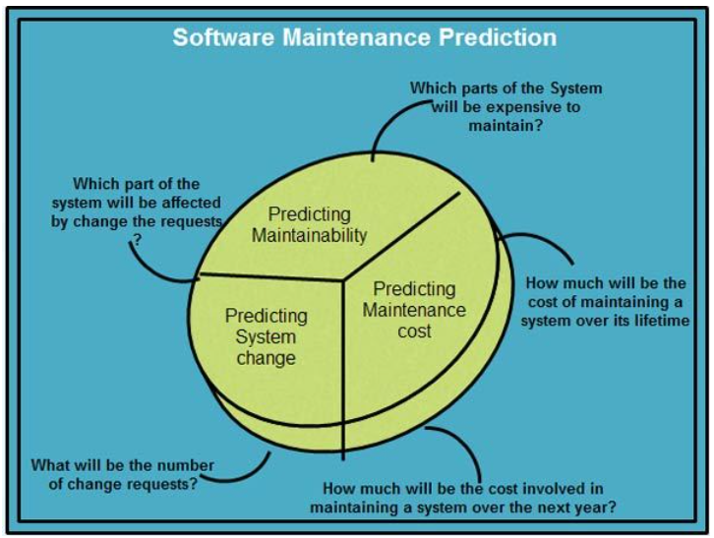
Continued….
1. Number and the complexity involved in the system interface. More interfaces mean more complexity, which in turn means more demand for change.
2. Number of system (volatile) requirements. Changes required in organizational policies and procedures tend to be more volatile than the requirements based on a particular domain.
3. Number of business processes in which the system operates. More business processes implies more demands for system change.

Slide 9
Continued….
After a system has been put into operation, several process metrics are used to predict the software maintainability. Process metrics, which may be useful for assessing maintainability, are listed below.
1. Corrective maintenance: Sometimes, more errors are introduced rather than being repaired during the maintenance process. This shows decline in maintainability.
2. Average time required for impact analysis: Before starting the software maintenance process, it is essential to analyze the impact of modifications in the software system. This is known as impact analysis, which reflects the number of components affected by the change.
3. Number of outstanding change requests: If the number of outstanding change requests increases with time, it may imply decline in maintainability.
4. Average time taken to implement a change request: This involves activities· concerned with making changes to the system and its documentation rather than simply assessing the components which are affected. If the time taken to implement a change increases, it may imply a decline in maintainability.

Slide 10
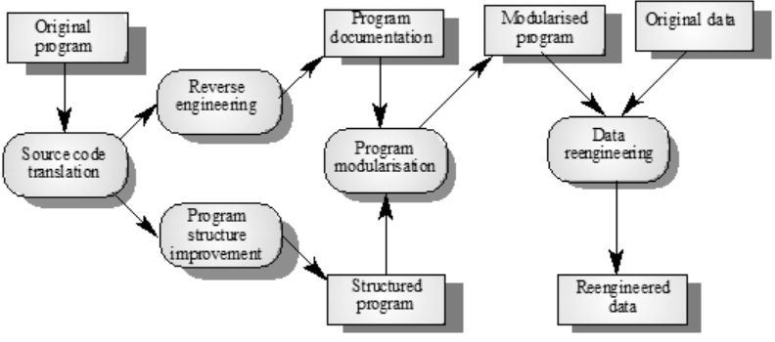
Software Reengineering
Software Reengineering is the process of updating software without affecting its functionality. This process may be done by developing additional features on the software and adding functionalities that may or may not be required but considered to make the software experience better and more efficient.
When do you decide to reengineer?
When system changes are confined to one subsystem, the subsystem needs to be reengineered
When hardware or software support becomes obsolete
When tools to support restructuring are readily available

Slide 11
Software Configuration Management
System Configuration Management (SCM) is an arrangement of exercises which controls change by recognizing the items for change, setting up connections between those things, making/characterizing instruments for overseeing diverse variants, controlling the changes being executed in the current framework, inspecting and revealing/reporting on the changes made.
Importance of Software Configuration Management:
There are multiple people working on software which is continually updating
It may be a case where multiple version, branches, authors are involved in a software config project, and the team is geographically distributed and works concurrently
Changes in user requirement, policy, budget, schedule need to be accommodated.
Software should able to run on various machines and Operating Systems
Helps to develop coordination among stakeholders
SCM process is also beneficial to control the costs involved in making changes to a system

Slide 12
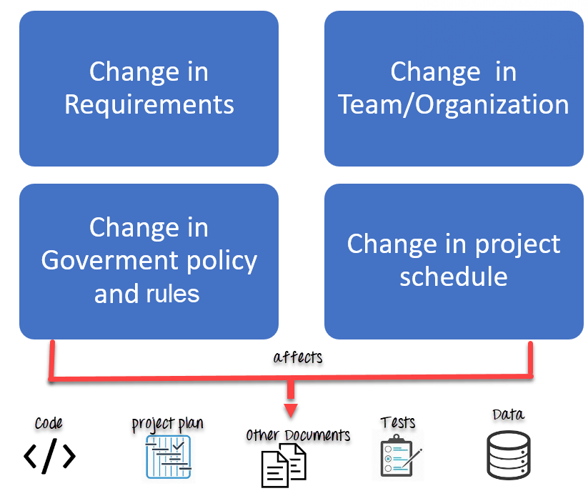
Continued….

Slide 13
Software Configuration Items
An aggregation of hardware, software, or both, that is designated for configuration management and treated as a single entity in the configuration management process
Software Configuration items are not only program code segments but all types of documents according to development, e.g.
- all types of code files
- drivers for tests
- analysis or design documents
- user or developer manuals
- system configuration (version of compiler used)
In some systems, not only software but also hardware configuration exist! E.g. CPUs, bus speed frequencies

Slide 14
Continued…..
Some configurations items are:
Requirement Analysis Document (RAD)
System Design Document (SDD)
Object Design Document (ODD)
Unit Tests
Source Code
Input Data and Data bases
Test Data
Once the configuration items are selected, they are usually organized in a tree

Slide 15
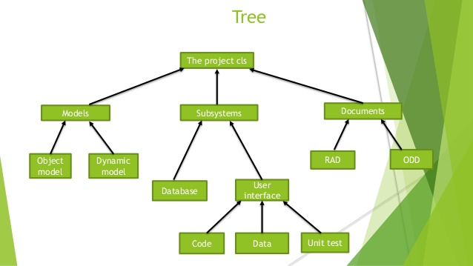
Continued….

Slide 16
Software Versioning
Software versioning is the process of numbering different releases of a particular software program for both internal use and release designation.
It allows programmers to know when changes have been made and track changes enforced in the software.
At the same time, it enables potential customers to be acquainted with new releases and recognize the updated versions.
In software versioning, subsequent releases of a specific product receive numerical identifiers consisting of two or three numbers separated by periods.
The first number, called the major number, is increased when there are significant improvements or changes in functionality.
The second number, called the minor number, is incremented when there are minor feature changes or significant fixes.
The third number, if it exists, is called the revision number. It is added or increased when minor bugs are eliminated.

Slide 17
Reference
https://ecomputernotes.com/software-engineering/software-maintenance#Software_Maintenance_Prediction

